Slide 1

Chapter 7: Multivariate Normal Distribution
Applied Multivariate Statistical Analysis
6th edition by Johnson & Wichern
$$π$$
Gabrielle Salamanca

Slide 2

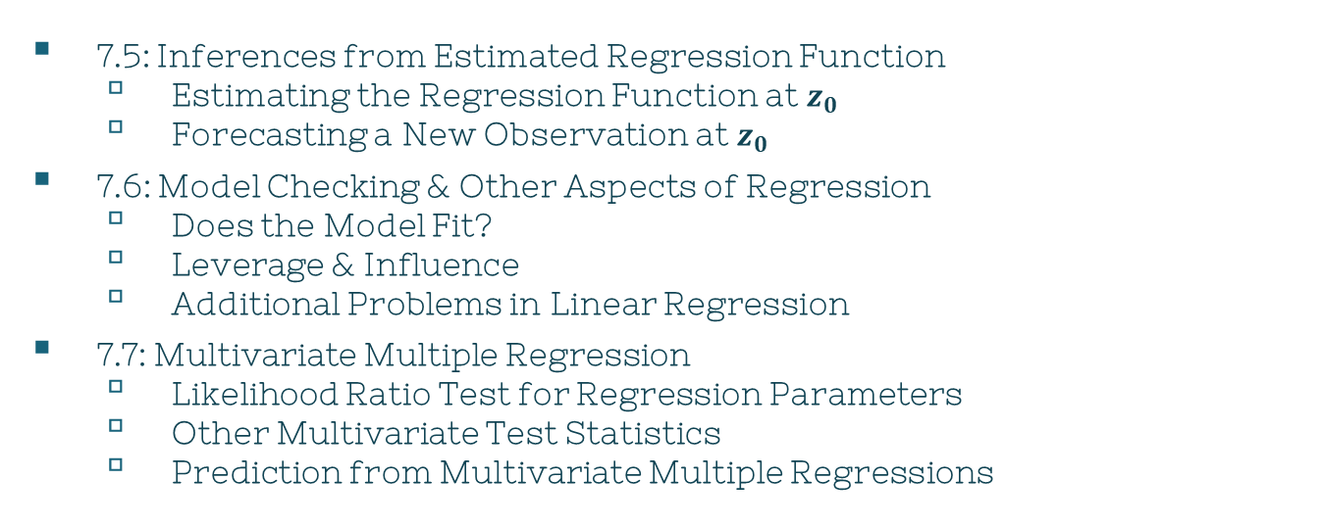
Overview
$$π$$
7.5: Inferences from Estimated Regression Function
Estimating the Regression Function at $z_{0}$
Forecasting a New Observation at $z_{0}$
7.6: Model Checking & Other Aspects of Regression
Does the Model Fit?
Leverage & Influence
Additional Problems in Linear Regression
7.7: Multivariate Multiple Regression
Likelihood Ratio Test for Regression Parameters
Other Multivariate Test Statistics
Prediction from Multivariate Multiple Regressions

Slide 3
Inferences from the Estimated Regression Function
1
Chapter 7, Section 5

Slide 4
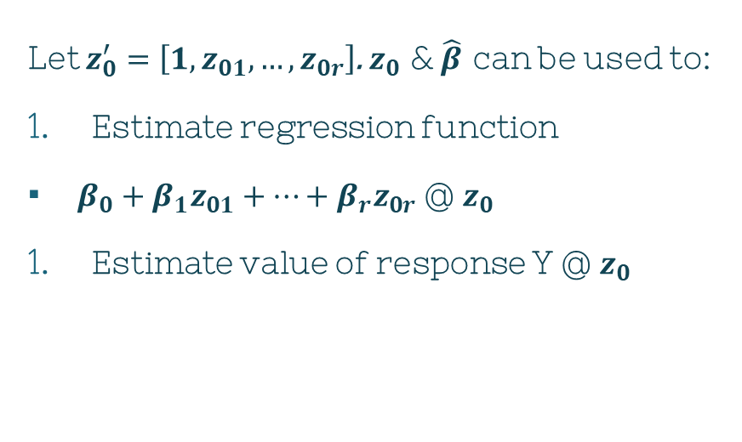

Once…
$$π$$
Let $z_{0}^{′}=\left[1,z_{01},…,z_{0r}\right]$. $z_{0}$ & $\hat{β}$ can be used to:
Estimate regression function
$β_{0}+β_{1}z_{01}+…+β_{r}z_{0r}$ @ $z_{0}$
Estimate value of response Y @ $z_{0}$
Satisfied w/ fitted regression model, it can be used to solve 2 prediction problems.

Slide 5
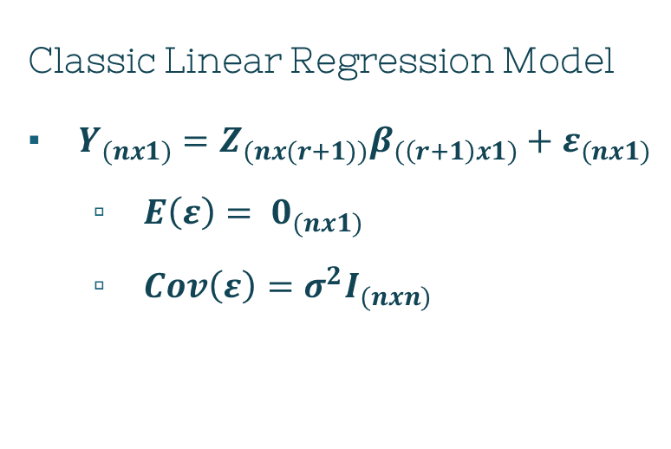

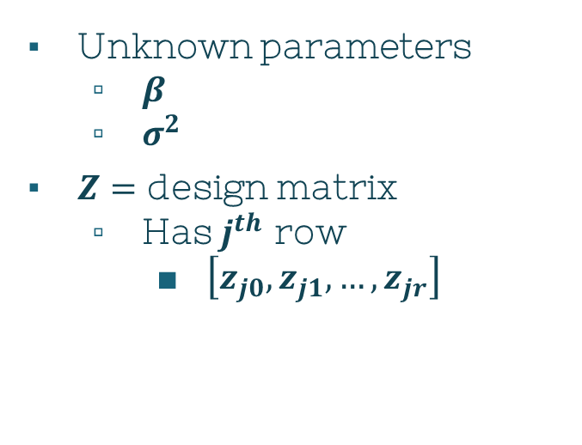
(7-3)
$$π$$
Classic Linear Regression Model
$Y_{(nx1)}=Z_{(nx(r+1))}β_{(\left(r+1\right)x1)}+ε_{(nx1)}$
$E\left(ε\right)= 0_{(nx1)}$
$Cov\left(ε\right)=σ^{2}I_{(nxn)}$
Unknown parameters
$β$
$σ^{2}$
$Z=$ design matrix
Has $j^{th}$ row
$\left[z_{j0},z_{j1},…,z_{jr}\right]$
Notes:
Beta = coefficient
Y = response/dependent
Z = independent var (replacing X)

Slide 6
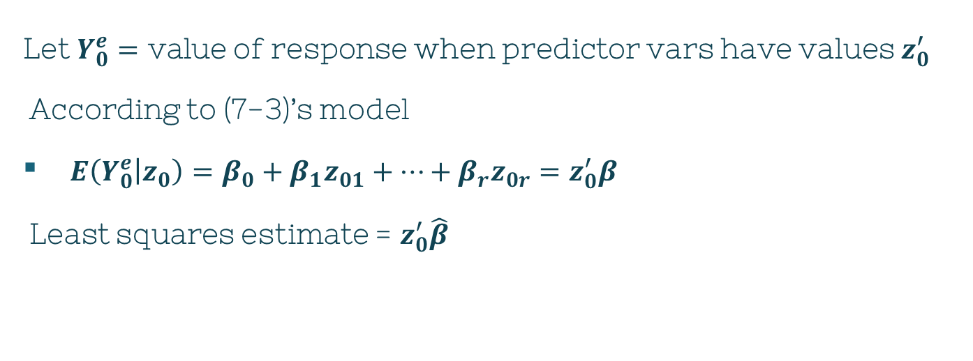

Estimation: Function @ $Z_{0}$
$$π$$
Let $Y_{0}^{e}=$ value of response when predictor vars have values $z_{0}^{′}$
According to (7-3)’s model
$E\left(Y_{0}^{e} | z_{0}\right)=β_{0}+β_{1}z_{01}+…+β_{r}z_{0r}=z_{0}^{′}β$
Least squares estimate = $z_{0}^{′}\hat{β}$

Slide 7
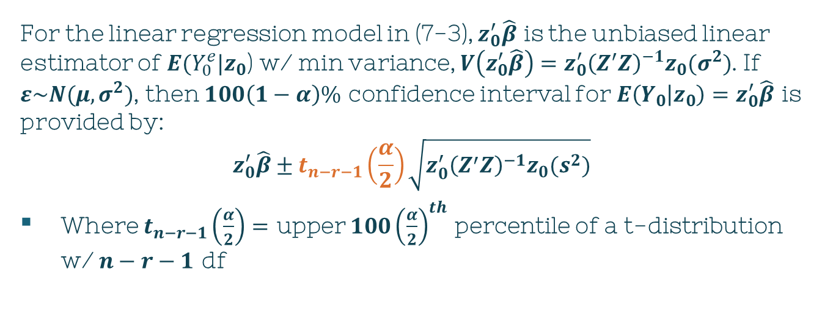
Result 7.7
$$π$$
For the linear regression model in (7-3), $z_{0}^{′}\hat{β}$ is the unbiased linear estimator of $E(Y_{0}^{e}|z_{0}$) w/ min variance, $V\left(z_{0}^{′}\hat{β}\right)=z_{0}^{′}{\left(Z^{′}Z\right)}^{−1}z_{0}(σ^{2})$. If $ε\sim N(μ,σ^{2})$, then $100\left(1−α\right)\%$ confidence interval for $E\left(Y_{0} | z_{0}\right)=z_{0}^{′}\hat{β}$ is provided by:
$$z_{0}^{′}\hat{β}±t_{n−r−1}\left(\frac{α}{2}\right)\sqrt{z_{0}^{′}{\left(Z^{′}Z\right)}^{−1}z_{0}(s^{2})}$$
Where $t_{n−r−1}\left(\frac{α}{2}\right)=$ upper $100{\left(\frac{α}{2}\right)}^{th}$ percentile of a t-distribution w/ $n−r−1$ df
Notes:
In previous chapters, most of the statistical techniques discussed in previous chapters assume that each vector observation Xj comes from a MVN distr. However, that normality assumption isn’t as important if the sample size is large and the techniques solely depend on Xbar matrix’s behavior or distances involving that matrix of the form n(Xbar - mu)’S-1(Xbar – mu)

Slide 8
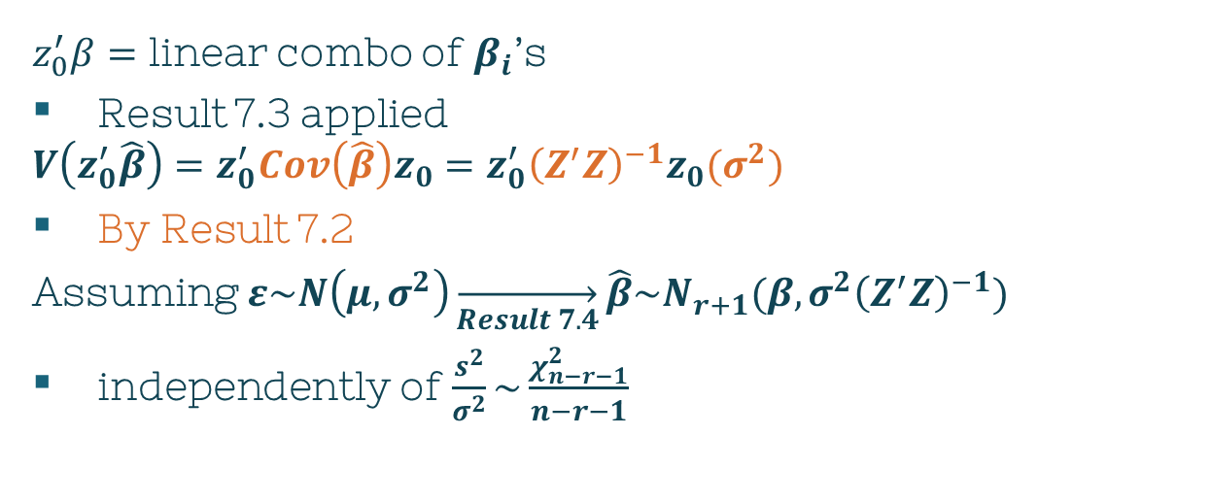
Result 7.7: Proof
$$π$$
$z_{0}^{′}β=$ linear combo of $β_{i}$’s
Result 7.3 applied
$$V\left(z_{0}^{′}\hat{β}\right)=z_{0}^{′}Cov\left(\hat{β}\right)z_{0}=z_{0}^{′}{\left(Z^{′}Z\right)}^{−1}z_{0}(σ^{2})$$
By Result 7.2
Assuming $ε\sim N\left(μ,σ^{2}\right)\overset{→}{Result 7.4}\hat{β}\sim N_{r+1}(β,σ^{2}{\left(Z^{′}Z\right)}^{−1})$
independently of $\frac{s^{2}}{σ^{2}}\sim \frac{χ_{n−r−1}^{2}}{n−r−1}$
Notes:
In previous chapters, most of the statistical techniques discussed in previous chapters assume that each vector observation Xj comes from a MVN distr. However, that normality assumption isn’t as important if the sample size is large and the techniques solely depend on Xbar matrix’s behavior or distances involving that matrix of the form n(Xbar - mu)’S-1(Xbar – mu)

Slide 9
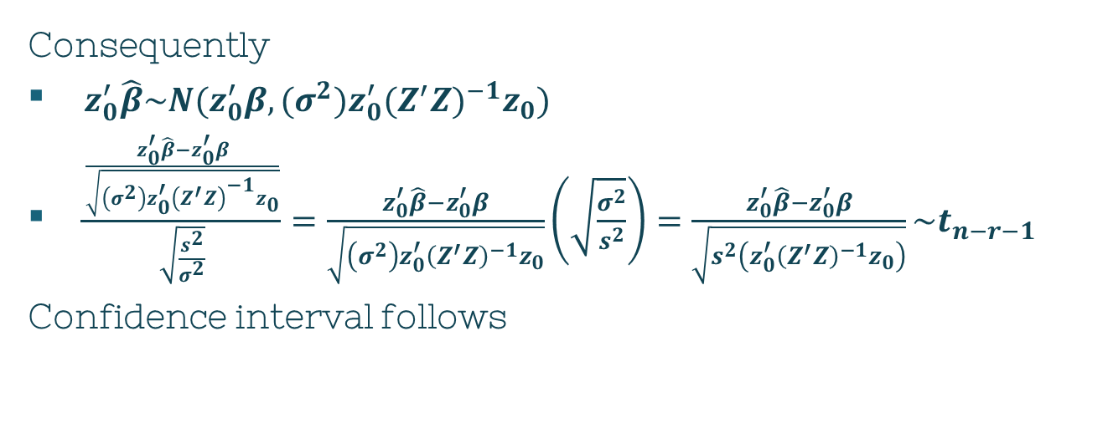
Result 7.7: Proof
$$π$$
Consequently
$z_{0}^{′}\hat{β}\sim N(z_{0}^{′}β,(σ^{2}){z_{0}^{′}(Z^{′}Z)}^{−1}z_{0})$
$\frac{\frac{z_{0}^{′}\hat{β}−z_{0}^{′}β}{\sqrt{\left(σ^{2}\right)z_{0}^{′}{\left(Z^{′}Z\right)}^{−1}z_{0}}}}{\sqrt{\frac{s^{2}}{σ^{2}}}}=\frac{z_{0}^{′}\hat{β}−z_{0}^{′}β}{\sqrt{\left(σ^{2}\right)z_{0}^{′}{\left(Z^{′}Z\right)}^{−1}z_{0}}}\left(\sqrt{\frac{σ^{2}}{s^{2}}}\right)=\frac{z_{0}^{′}\hat{β}−z_{0}^{′}β}{\sqrt{s^{2}\left(z_{0}^{′}{\left(Z^{′}Z\right)}^{−1}z_{0}\right)}}\sim t_{n−r−1}$
Confidence interval follows
Notes:
In previous chapters, most of the statistical techniques discussed in previous chapters assume that each vector observation Xj comes from a MVN distr. However, that normality assumption isn’t as important if the sample size is large and the techniques solely depend on Xbar matrix’s behavior or distances involving that matrix of the form n(Xbar - mu)’S-1(Xbar – mu)

Slide 10
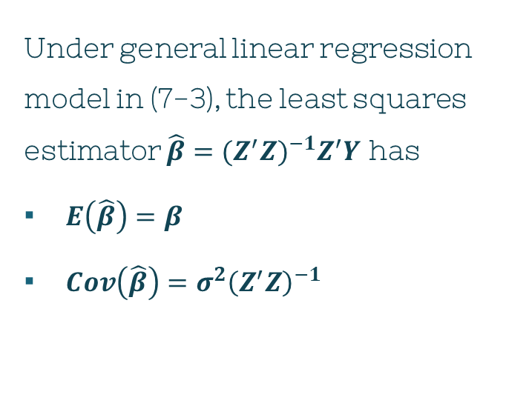
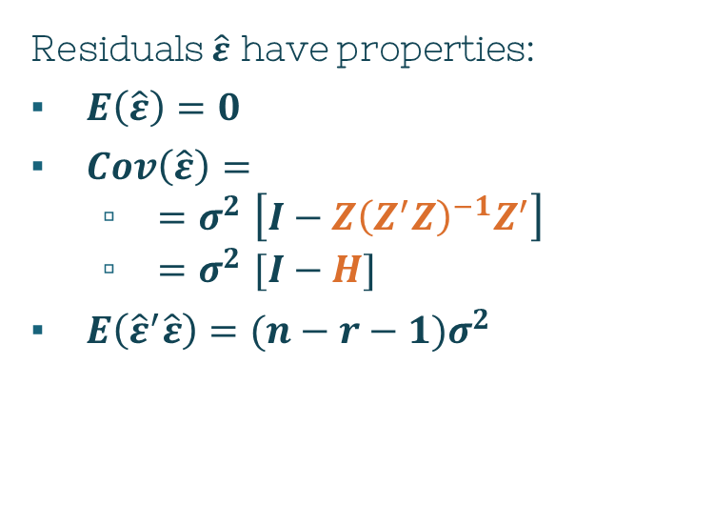
Result 7.2
$$π$$
Under general linear regression model in (7-3), the least squares estimator $\hat{β}={(Z^{′}Z)}^{−1}Z^{′}Y$ has
$E\left(\hat{β}\right)=β$
$Cov\left(\hat{β}\right)=σ^{2}{\left(Z^{′}Z\right)}^{−1}$
Residuals $\hat{ε}$ have properties:
$E\left(\hat{ε}\right)=0$
$Cov\left(\hat{ε}\right)=$
${=σ}^{2}\left[I−Z{\left(Z^{′}Z\right)}^{−1}Z^{′}\right]$
${=σ}^{2}[I−H]$
$E\left({\hat{ε}}^{′}\hat{ε}\right)=(n−r−1)σ^{2}$
Notes:
In previous chapters, most of the statistical techniques discussed in previous chapters assume that each vector observation Xj comes from a MVN distr. However, that normality assumption isn’t as important if the sample size is large and the techniques solely depend on Xbar matrix’s behavior or distances involving that matrix of the form n(Xbar - mu)’S-1(Xbar – mu)

Slide 11
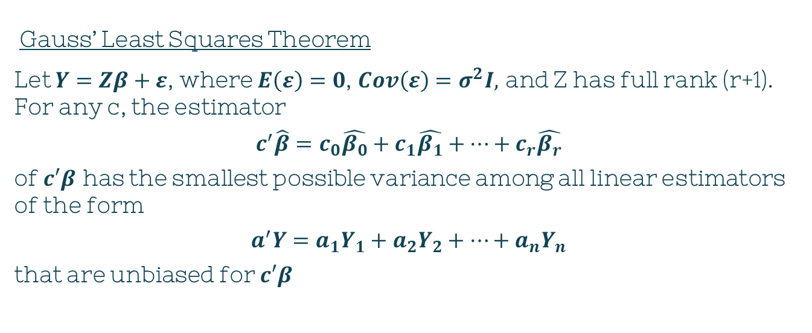
Result 7.3
$$π$$
Gauss’ Least Squares Theorem
Let $Y=Zβ+ε$, where $E\left(ε\right)=0$, $Cov\left(ε\right)=σ^{2}I,$ and Z has full rank (r+1). For any c, the estimator
$c^{′}\hat{β}=c_{0}\hat{β_{0}}+c_{1}\hat{β_{1}}+…+c_{r}\hat{β_{r}}$
of $c′β$ has the smallest possible variance among all linear estimators of the form
$a^{′}Y=a_{1}Y_{1}+a_{2}Y_{2}+…+a_{n}Y_{n}$
that are unbiased for $c′β$
Notes:
In previous chapters, most of the statistical techniques discussed in previous chapters assume that each vector observation Xj comes from a MVN distr. However, that normality assumption isn’t as important if the sample size is large and the techniques solely depend on Xbar matrix’s behavior or distances involving that matrix of the form n(Xbar - mu)’S-1(Xbar – mu)

Slide 12
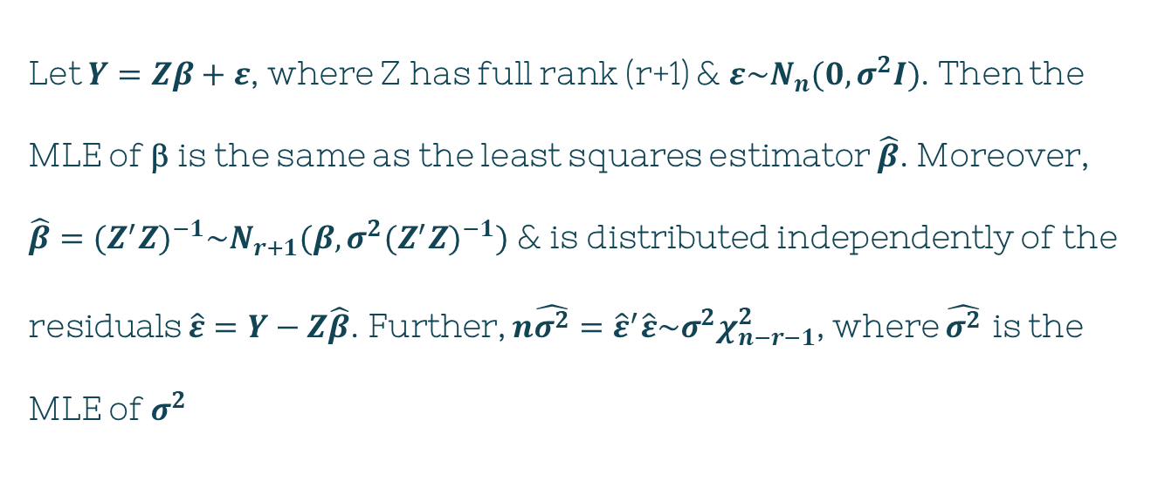
Result 7.4
$$π$$
Let $Y=Zβ+ε$, where Z has full rank (r+1) & $ε\sim N_{n}(0,σ^{2}I)$. Then the MLE of β is the same as the least squares estimator $\hat{β}$. Moreover, $\hat{β}={(Z^{′}Z)}^{−1}\sim N_{r+1}(β,σ^{2}{(Z^{′}Z)}^{−1})$ & is distributed independently of the residuals $\hat{ε}=Y−Z\hat{β}$. Further, $n\hat{σ^{2}}={\hat{ε}}^{′}\hat{ε}\sim σ^{2}χ_{n−r−1}^{2}$, where $\hat{σ^{2}}$ is the MLE of $σ^{2}$
Notes:
In previous chapters, most of the statistical techniques discussed in previous chapters assume that each vector observation Xj comes from a MVN distr. However, that normality assumption isn’t as important if the sample size is large and the techniques solely depend on Xbar matrix’s behavior or distances involving that matrix of the form n(Xbar - mu)’S-1(Xbar – mu)

Slide 13
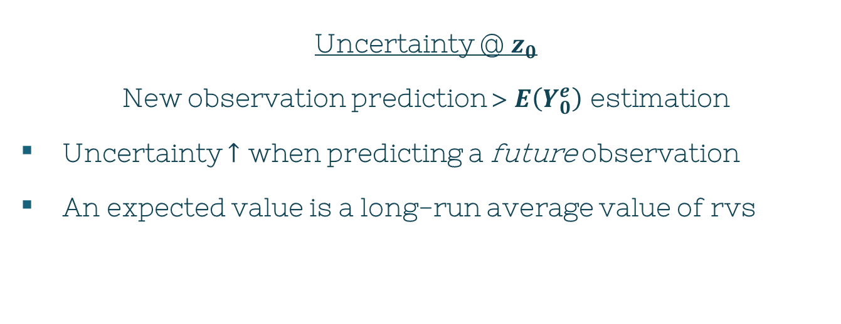

Forecast: Observation @ $Z_{0}$
$$π$$
Uncertainty @ $z_{0}$
New observation prediction > $E\left(Y_{0}^{e}\right)$ estimation
Uncertainty $↑$ when predicting a future observation
An expected value is a long-run average value of rvs

Slide 14
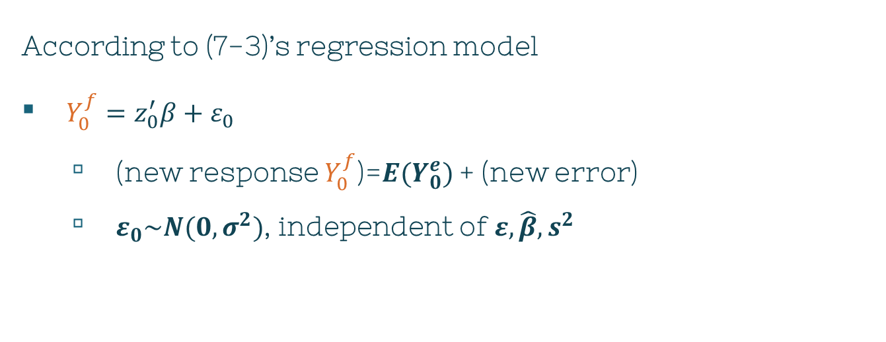
Forecast: Observation @ $Z_{0}$
$$π$$
According to (7-3)’s regression model
$Y_{0}^{f}=z_{0}^{′}β+ε_{0}$
(new response $Y_{0}^{f}$)=$E(Y_{0}^{e})$ + (new error)
$ε_{0}\sim N(0,σ^{2})$, independent of $ε, \hat{β},s^{2}$

Slide 15
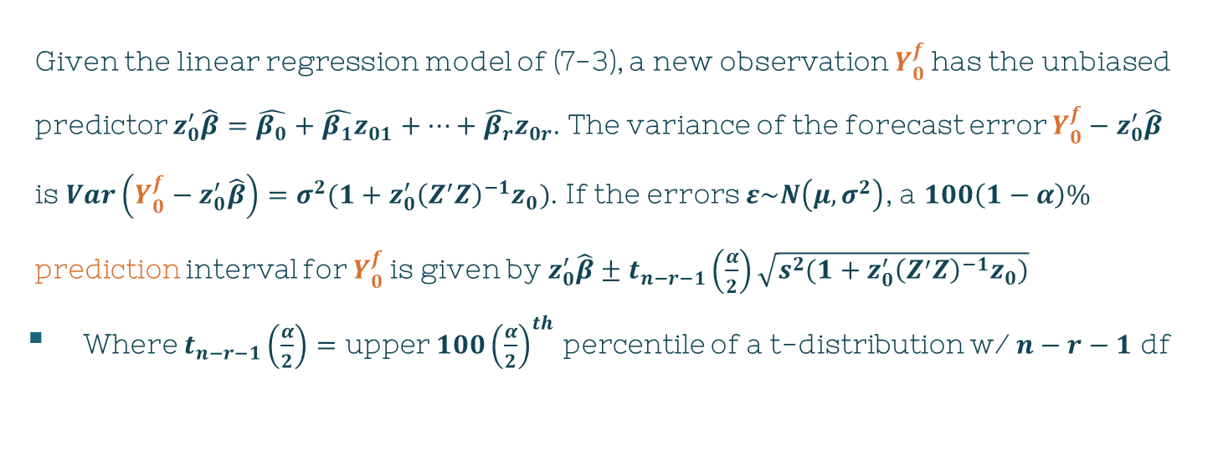
Result 7.8
$$π$$
Given the linear regression model of (7-3), a new observation $Y_{0}^{f}$has the unbiased predictor $z_{0}^{′}\hat{β}=\hat{β_{0}}+\hat{β_{1}}z_{01}+…+\hat{β_{r}}z_{0r}$. The variance of the forecast error $Y_{0}^{f}−z_{0}^{′}\hat{β}$ is $Var\left(Y_{0}^{f}−z_{0}^{′}\hat{β}\right)=σ^{2}(1+z_{0}^{′}{\left(Z^{′}Z\right)}^{−1}z_{0})$. If the errors $ε\sim N\left(μ,σ^{2}\right)$, a $100\left(1−α\right)\%$ prediction interval for $Y_{0}^{f}$is given by $z_{0}^{′}\hat{β}±t_{n−r−1}\left(\frac{α}{2}\right)\sqrt{s^{2}(1+z_{0}^{′}{\left(Z^{′}Z\right)}^{−1}z_{0})}$
Where $t_{n−r−1}\left(\frac{α}{2}\right)=$ upper $100{\left(\frac{α}{2}\right)}^{th}$ percentile of a t-distribution w/ $n−r−1$ df
Notes:
In previous chapters, most of the statistical techniques discussed in previous chapters assume that each vector observation Xj comes from a MVN distr. However, that normality assumption isn’t as important if the sample size is large and the techniques solely depend on Xbar matrix’s behavior or distances involving that matrix of the form n(Xbar - mu)’S-1(Xbar – mu)

Slide 16
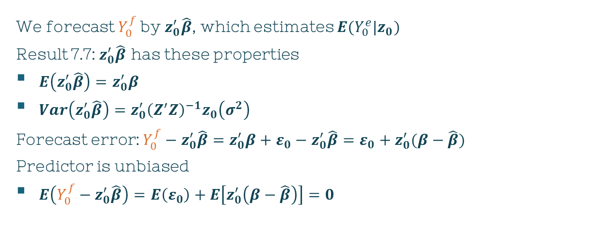
Result 7.8: Proof
$$π$$
We forecast $Y_{0}^{f}$by $z_{0}^{′}\hat{β}$, which estimates $E(Y_{0}^{e}|z_{0})$
Result 7.7: $z_{0}^{′}\hat{β}$ has these properties
$E\left(z_{0}^{′}\hat{β}\right)=z_{0}^{′}β$
$Var\left(z_{0}^{′}\hat{β}\right)=z_{0}^{′}{\left(Z^{′}Z\right)}^{−1}z_{0}\left(σ^{2}\right)$
Forecast error: $Y_{0}^{f}−z_{0}^{′}\hat{β}=z_{0}^{′}β+ε_{0}−z_{0}^{′}\hat{β}={ε_{0}+z}_{0}^{′}(β−\hat{β})$
Predictor is unbiased
$E\left(Y_{0}^{f}−z_{0}^{′}\hat{β}\right)=E\left(ε_{0}\right)+E\left[z_{0}^{′}\left(β−\hat{β}\right)\right]=0$
Notes:
In previous chapters, most of the statistical techniques discussed in previous chapters assume that each vector observation Xj comes from a MVN distr. However, that normality assumption isn’t as important if the sample size is large and the techniques solely depend on Xbar matrix’s behavior or distances involving that matrix of the form n(Xbar - mu)’S-1(Xbar – mu)

Slide 17

Result 7.8: Proof
$$π$$
Because $ε_{0}$ & $\hat{β}$ are independent
$Var\left(Y_{0}^{f}−z_{0}^{′}\hat{β}\right)=Var\left(ε_{0}\right)+Var\left(z_{0}^{′}\hat{β}\right)=σ^{2}+z_{0}^{′}{\left(Z^{′}Z\right)}^{−1}z_{0}\left(σ^{2}\right)=σ^{2}[1+z_{0}^{′}{\left(Z^{′}Z\right)}^{−1}z_{0}]$
Further assumptions
$ε\sim N\left(0,σ^{2}\right)$
$⇒\hat{β}\sim N\left(0,σ^{2}\right)$
${⇒Y}_{0}^{f}\sim N\left(0,σ^{2}\right)$
Notes:
In previous chapters, most of the statistical techniques discussed in previous chapters assume that each vector observation Xj comes from a MVN distr. However, that normality assumption isn’t as important if the sample size is large and the techniques solely depend on Xbar matrix’s behavior or distances involving that matrix of the form n(Xbar - mu)’S-1(Xbar – mu)

Slide 18
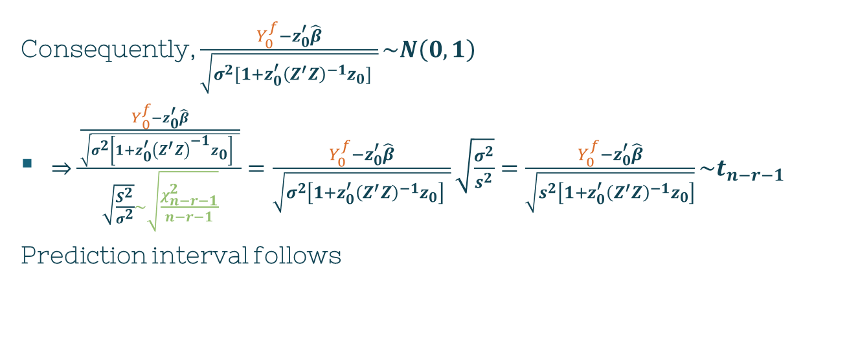
Result 7.8: Proof
$$π$$
Consequently, $\frac{Y_{0}^{f}−z_{0}^{′}\hat{β}}{\sqrt{σ^{2}[1+z_{0}^{′}{\left(Z^{′}Z\right)}^{−1}z_{0}] }}\sim N\left(0,1\right)$
$⇒\frac{\frac{Y_{0}^{f}−z_{0}^{′}\hat{β}}{\sqrt{σ^{2}\left[1+z_{0}^{′}{\left(Z^{′}Z\right)}^{−1}z_{0}\right] }}}{\sqrt{\frac{S^{2}}{σ^{2}}}\sim \sqrt{\frac{χ_{n−r−1}^{2}}{n−r−1}}}=\frac{Y_{0}^{f}−z_{0}^{′}\hat{β}}{\sqrt{σ^{2}\left[1+z_{0}^{′}{\left(Z^{′}Z\right)}^{−1}z_{0}\right] }}\sqrt{\frac{σ^{2}}{s^{2}}}=\frac{Y_{0}^{f}−z_{0}^{′}\hat{β}}{\sqrt{s^{2}\left[1+z_{0}^{′}{\left(Z^{′}Z\right)}^{−1}z_{0}\right]}}\sim t_{n−r−1}$
Prediction interval follows
Notes:
In previous chapters, most of the statistical techniques discussed in previous chapters assume that each vector observation Xj comes from a MVN distr. However, that normality assumption isn’t as important if the sample size is large and the techniques solely depend on Xbar matrix’s behavior or distances involving that matrix of the form n(Xbar - mu)’S-1(Xbar – mu)

Slide 19
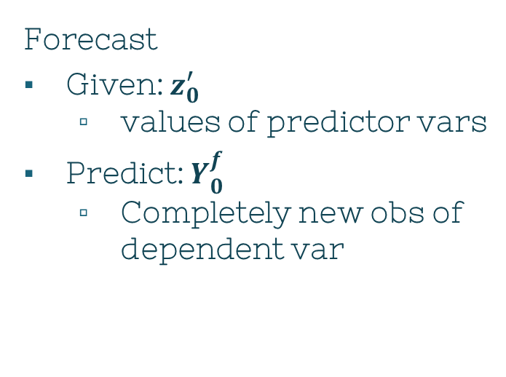
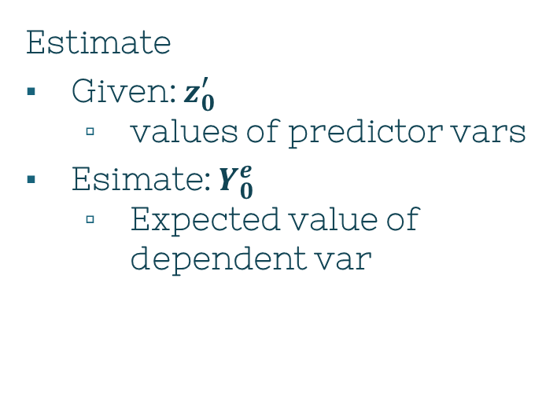
Define
$$π$$
Estimate
Given: $z_{0}^{′}$
values of predictor vars
Esimate: $Y_{0}^{e}$
Expected value of dependent var
Forecast
Given: $z_{0}^{′}$
values of predictor vars
Predict: $Y_{0}^{f}$
Completely new obs of dependent var

Slide 20
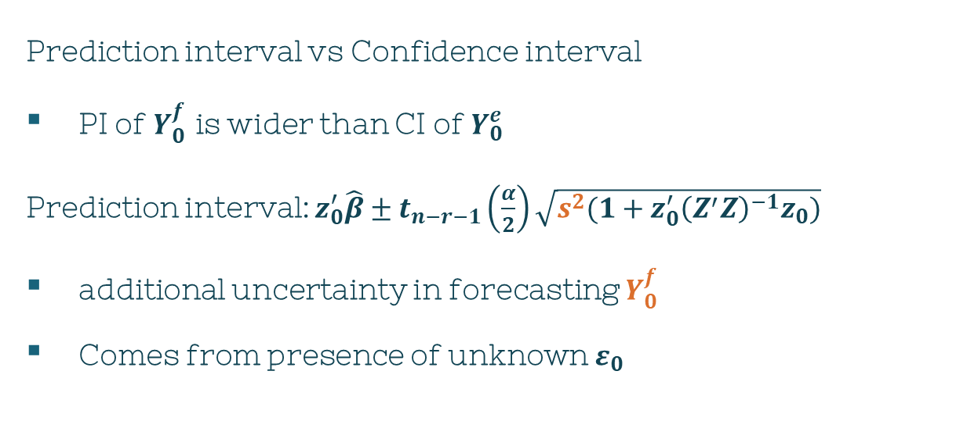
Note
Prediction interval vs Confidence interval
PI of $Y_{0}^{f}$ is wider than CI of $Y_{0}^{e}$
Prediction interval: $z_{0}^{′}\hat{β}±t_{n−r−1}\left(\frac{α}{2}\right)\sqrt{s^{2}(1+z_{0}^{′}{\left(Z^{′}Z\right)}^{−1}z_{0})}$
additional uncertainty in forecasting $Y_{0}^{f}$
Comes from presence of unknown $ε_{0}$

Slide 21
Model Checking & Other Aspects of Regression
2
Chapter 7, Section 6

Slide 22
Does the Model Fit?
Important!
Even IF we assume the model is “correct”
ALWAYS, always examine its adequacy before using the estimated function
Why?
If model does not adequately fit the data
Any conclusions made with the model will be called into question

Slide 23

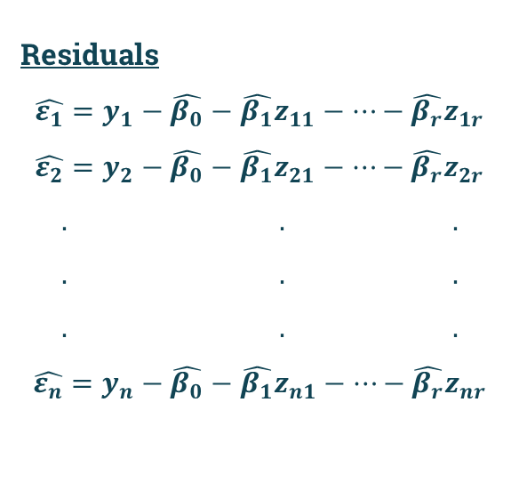
Does the Model Fit?
$$π$$
Residuals
$$\hat{ε_{1}}=y_{1}−\hat{β_{0}}−\hat{β_{1}}z_{11}−…−\hat{β_{r}}z_{1r}$$
$$\hat{ε_{2}}=y_{2}−\hat{β_{0}}−\hat{β_{1}}z_{21}−…−\hat{β_{r}}z_{2r}$$
$$. . .$$
$$. . .$$
$$. . .$$
$$\hat{ε_{n}}=y_{n}−\hat{β_{0}}−\hat{β_{1}}z_{n1}−…−\hat{β_{r}}z_{nr}$$
(7-16)
$$\hat{ε}=\left[I−Z{\left(Z^{′}Z\right)}^{−1}Z^{′}\right]y$$
$H={Z\left(Z^{′}Z\right)}^{−1}Z^{′}$
$$\hat{ε}=\left[I−H\right]y$$

Slide 24
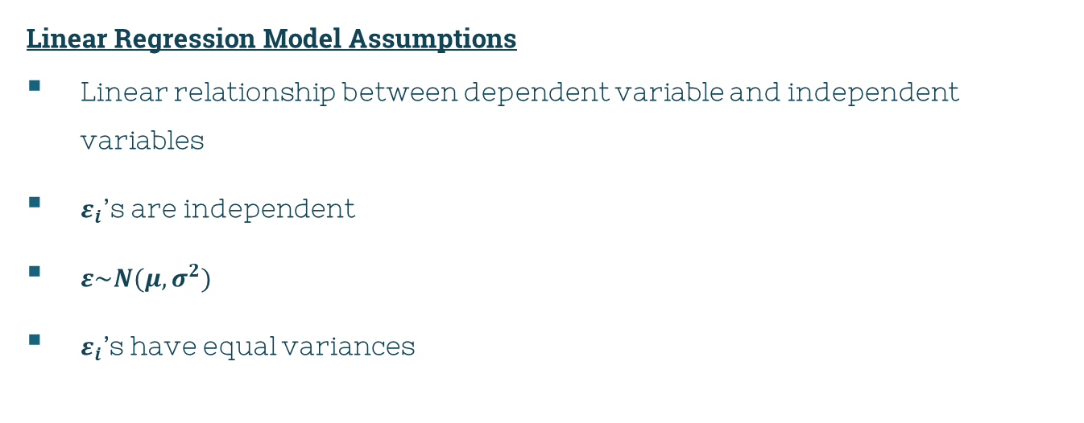
Does the Model Fit?
$$π$$
Linear Regression Model Assumptions
Linear relationship between dependent variable and independent variables
$ε_{i}$’s are independent
$ε\sim N(μ,σ^{2})$
$ε_{i}\text{’}\text{s}$ have equal variances

Slide 25
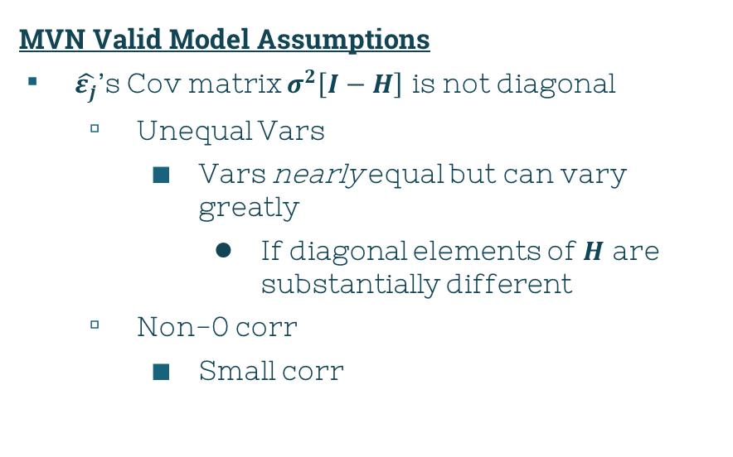
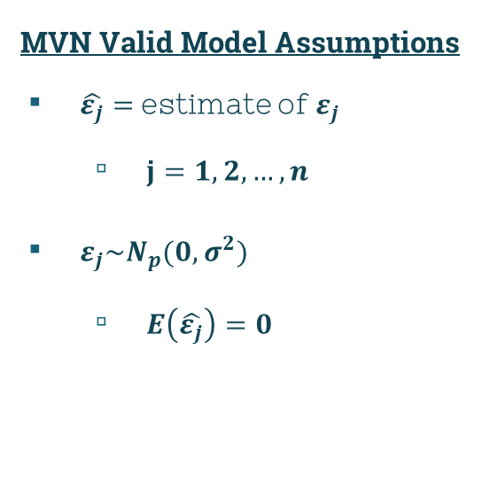
Does the Model Fit?
$$π$$
MVN Valid Model Assumptions
$\hat{ε_{j}}=$ estimate of $ε_{j}$
$j=1,2,…,n$
$ε_{j}\sim N_{p}(0,σ^{2})$
$E\left(\hat{ε_{j}}\right)=0$
MVN Valid Model Assumptions
$\hat{ε_{j}}$’s Cov matrix $σ^{2}\left[I−H\right]$ is not diagonal
Unequal Vars
Vars nearly equal but can vary greatly
If diagonal elements of $H$ are substantially different
Non-0 corr
Small corr

Slide 26
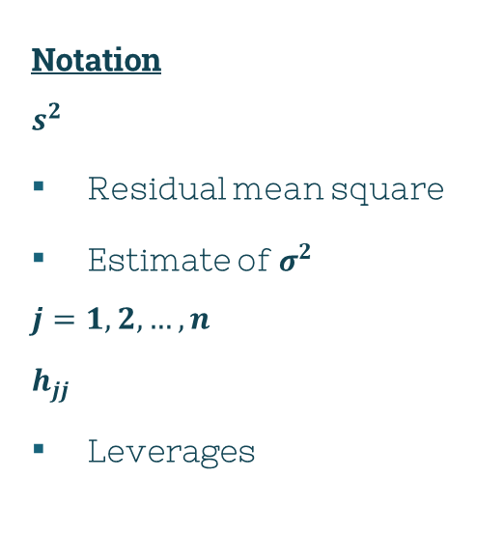
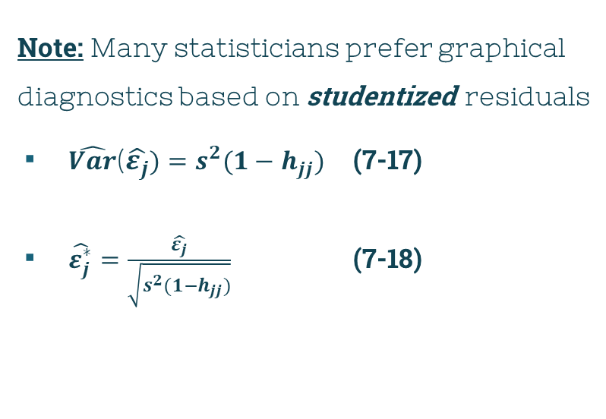
Does the Model Fit?
$$π$$
Note: Many statisticians prefer graphical diagnostics based on studentized residuals
$\hat{Var}$($\hat{ε_{j}})=s^{2}(1−h_{jj})$ (7-17)
$\hat{ε_{j}^{∗}}=\frac{\hat{ε_{j}}}{\sqrt{s^{2}(1−h_{jj})}}$ (7-18)
Notation
$$s^{2}$$
Residual mean square
Estimate of $σ^{2}$
$$j=1, 2,…,n$$
$$h_{jj}$$
Leverages

Slide 27
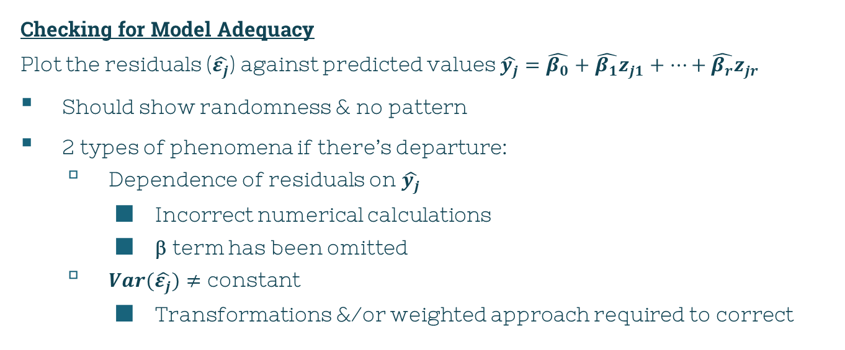
Does the Model Fit?
$$π$$
Checking for Model Adequacy
Plot the residuals ($\hat{ε_{j}}$) against predicted values $\hat{y_{j}}=\hat{β_{0}}+\hat{β_{1}}z_{j1}+…+\hat{β_{r}}z_{jr}$
Should show randomness & no pattern
2 types of phenomena if there’s departure:
Dependence of residuals on $\hat{y_{j}}$
Incorrect numerical calculations
β term has been omitted
$Var(\hat{ε_{j}})≠$ constant
Transformations &/or weighted approach required to correct

Slide 28
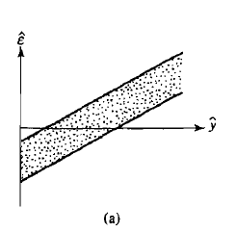
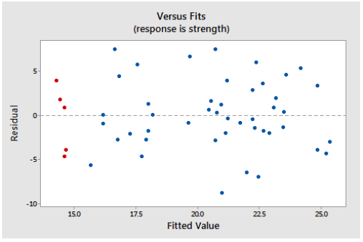

X
Figure 7.2.a: $\hat{y_{j}}$ dependence
Source: https://online.stat.psu.edu/stat501/lesson/4/4.3

Slide 29
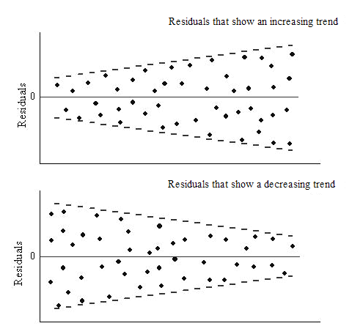
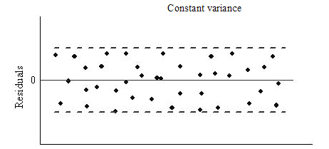
X
Source: https://www.originlab.com/doc/Origin-Help/Residual-Plot-Analysis

Slide 30
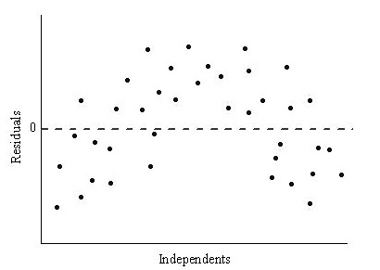
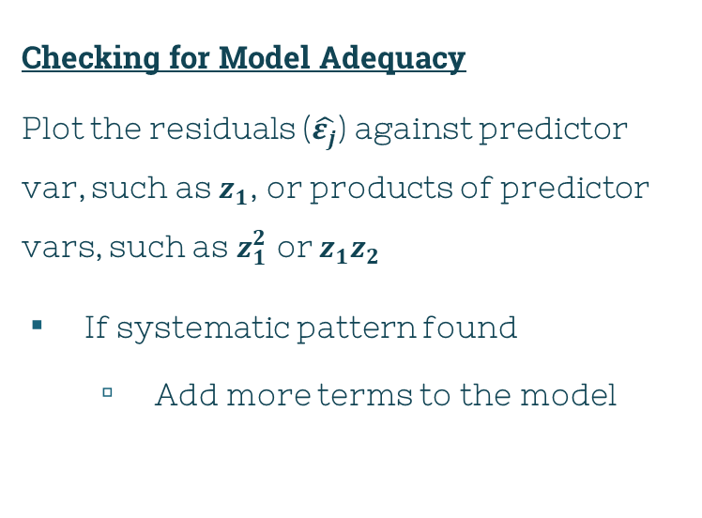
Does the Model Fit?
$$π$$
Checking for Model Adequacy
Plot the residuals ($\hat{ε_{j}}$) against predictor var, such as $z_{1}$, or products of predictor vars, such as $z_{1}^{2}$ or $z_{1}z_{2}$
If systematic pattern found
Add more terms to the model
Source: https://www.originlab.com/doc/Origin-Help/Residual-Plot-Analysis

Slide 31
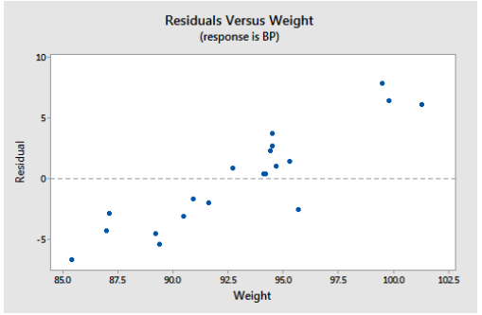
Source: https://online.stat.psu.edu/stat501/lesson/4/4.3

Slide 32
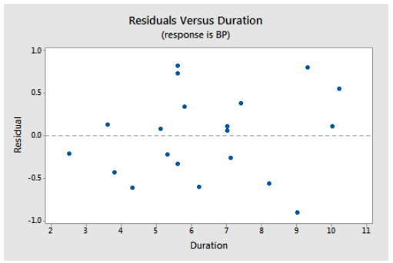
Source: https://online.stat.psu.edu/stat501/lesson/4/4.3

Slide 33
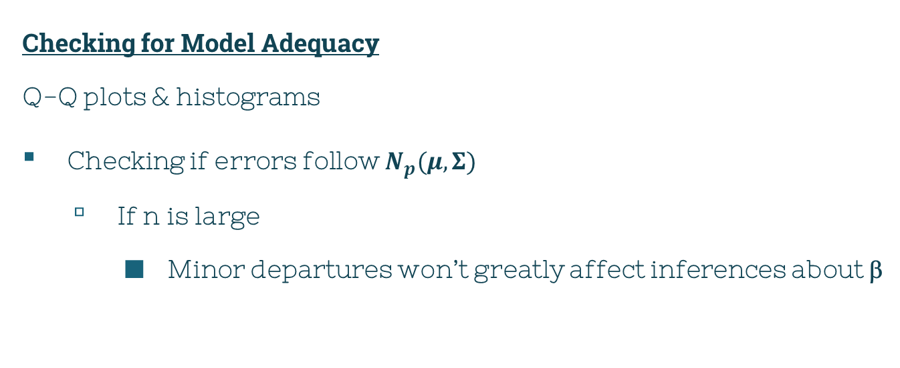
Does the Model Fit?
$$π$$
Checking for Model Adequacy
Q-Q plots & histograms
Checking if errors follow $N_{p}(μ,Σ)$
If n is large
Minor departures won’t greatly affect inferences about β

Slide 34
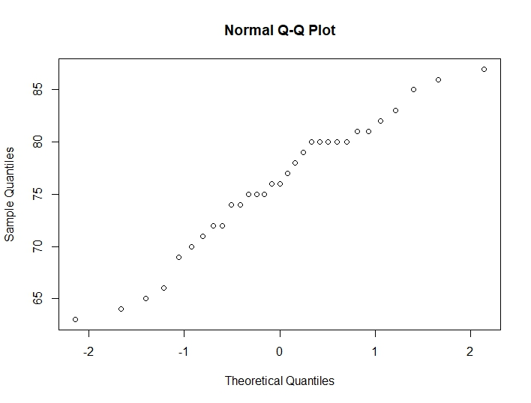
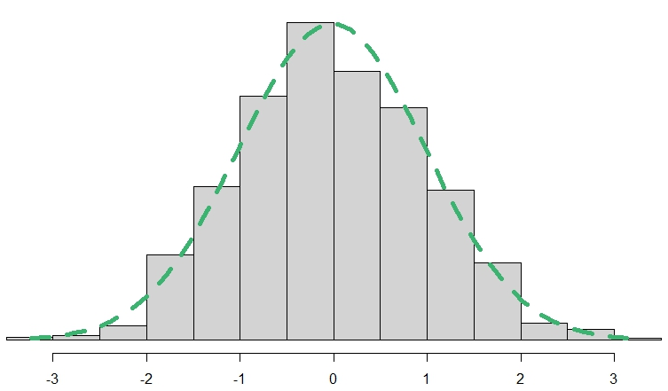
Normality Examples in R

Slide 35
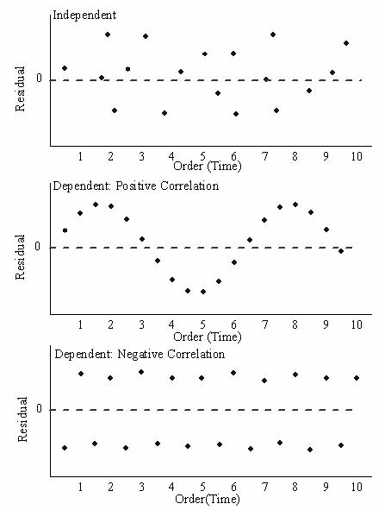
Does the Model Fit?
$$π$$
Checking for Model Adequacy
Plot the residuals vs time
Independence
Crucial assumption
Pattern?
No = independent
Yes = dependent
Source: https://www.originlab.com/doc/Origin-Help/Residual-Plot-Analysis

Slide 36
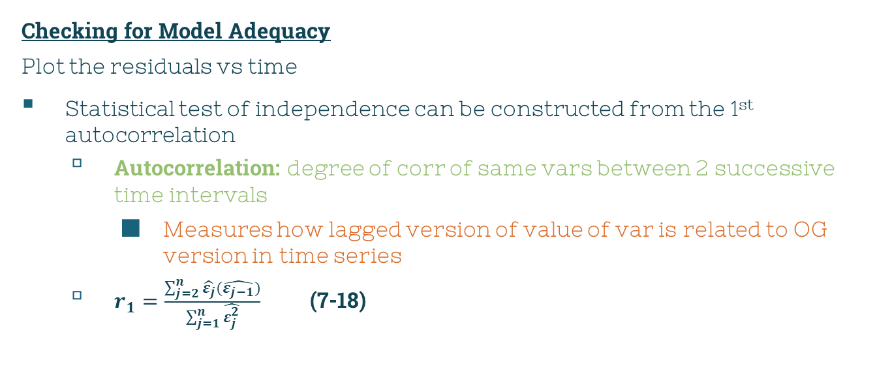
Does the Model Fit?
$$π$$
Checking for Model Adequacy
Plot the residuals vs time
Statistical test of independence can be constructed from the 1st autocorrelation
Autocorrelation: degree of corr of same vars between 2 successive time intervals
Measures how lagged version of value of var is related to OG version in time series
$r_{1}=\frac{\sum_{j=2}^{n}{\hat{ε_{j}}}(\hat{ε_{j−1}})}{\sum_{j=1}^{n}{\hat{ε_{j}^{2}}}}$ (7-18)

Slide 37
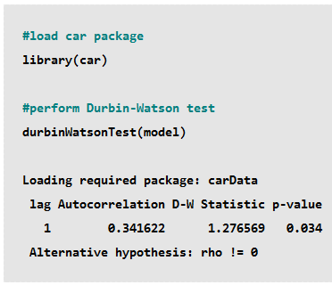
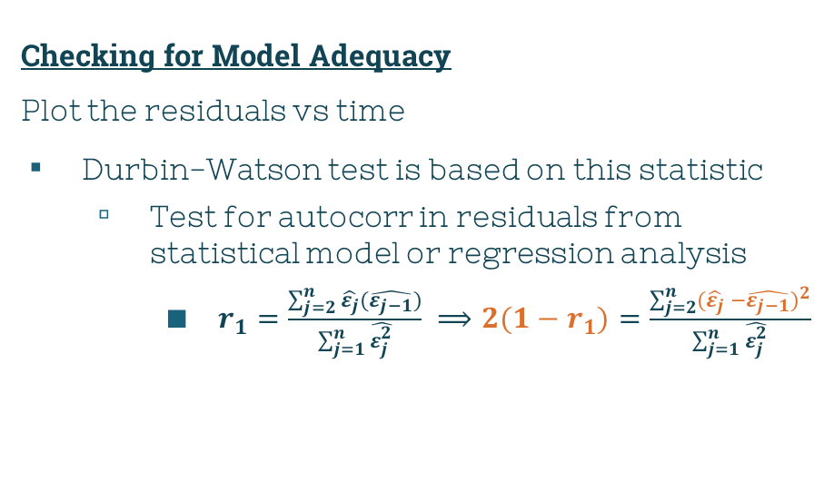
Does the Model Fit?
$$π$$
Checking for Model Adequacy
Plot the residuals vs time
Durbin-Watson test is based on this statistic
Test for autocorr in residuals from statistical model or regression analysis
$r_{1}=\frac{\sum_{j=2}^{n}{\hat{ε_{j}}}(\hat{ε_{j−1}})}{\sum_{j=1}^{n}{\hat{ε_{j}^{2}}}} ⟹2(1−r_{1})=\frac{\sum_{j=2}^{n}{{(\hat{ε_{j}} −\hat{ε_{j−1}})}^{2}}}{\sum_{j=1}^{n}{\hat{ε_{j}^{2}}}}$
Source: https://www.statology.org/durbin-watson-test-r/

Slide 38
Does the Model Fit?
$$π$$
Checking for Model Adequacy
Plot the residuals vs time
If autocorr detected
(+) ⇒ add lags of dependent &/or independent var to model
Lag: some past event from some point in time
(-) ⇒ check if your vars are over-differenced
Difference: change between consecutive obs in original time series
seasonal ⇒ add seasonal dummy vars to model

Slide 39
Leverage & Influence
$$π$$
Despite our thorough residual analysis, there still could be hidden departures from fitting our model!
Outliers in response or explanatory vars
Could have considerable effect on analysis that aren’t easily detectable from residual analysis

Slide 40

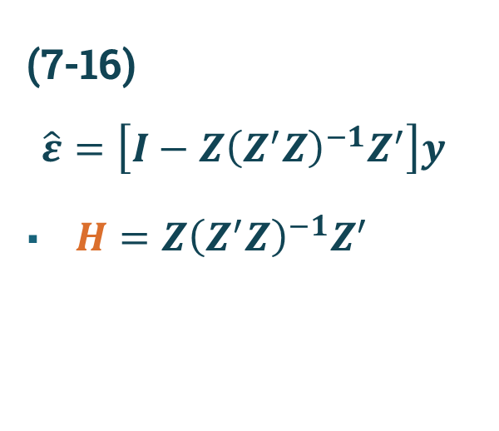
Leverage & Influence
$$π$$
(7-16)
$$\hat{ε}=\left[I−Z{\left(Z^{′}Z\right)}^{−1}Z^{′}\right]y$$
$H={Z\left(Z^{′}Z\right)}^{−1}Z^{′}$
$$h_{jj}$$
$(j,j)$diag of H
Leverage

Slide 41
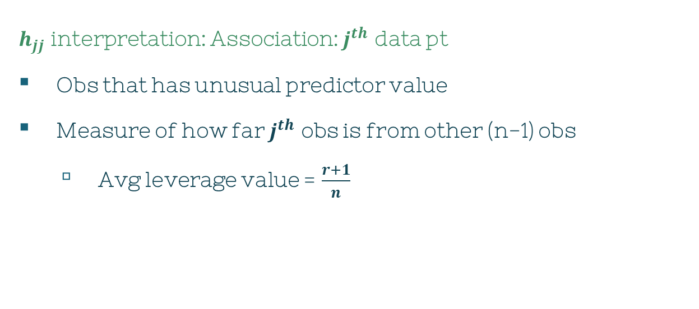
Leverage & Influence
$$π$$
$h_{jj}$ interpretation: Association: $j^{th}$ data pt
Obs that has unusual predictor value
Measure of how far $j^{th}$ obs is from other (n-1) obs
Avg leverage value = $\frac{r+1}{n}$

Slide 42
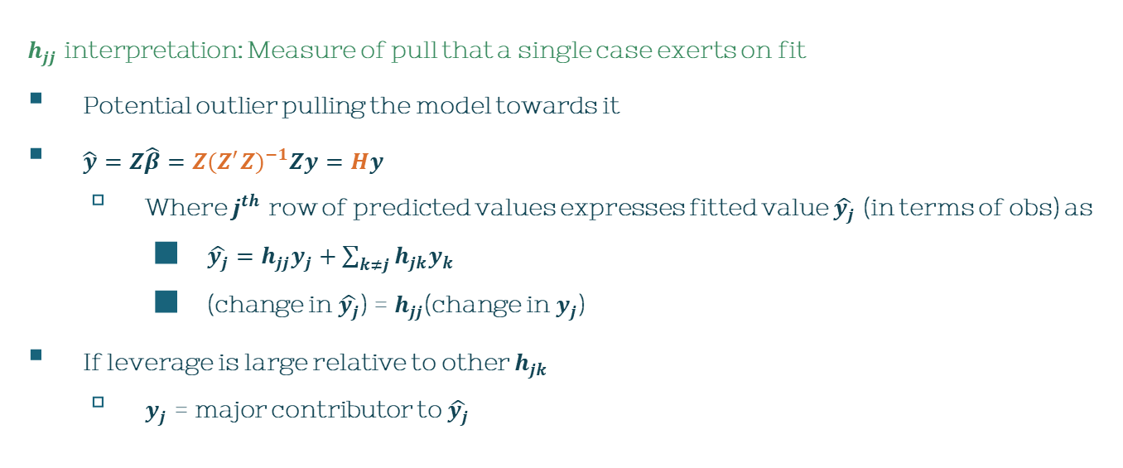
Leverage & Influence
$$π$$
$h_{jj}$ interpretation: Measure of pull that a single case exerts on fit
Potential outlier pulling the model towards it
$\hat{y}=Z\hat{β}=Z{(Z^{′}Z)}^{−1}Zy=Hy$
Where $j^{th}$ row of predicted values expresses fitted value $\hat{y_{j}}$ (in terms of obs) as
$\hat{y_{j}}=h_{jj}y_{j}+\sum_{k≠j}{h_{jk}y_{k}}$
(change in $\hat{y_{j}}$) = $h_{jj}$(change in $y_{j}$)
If leverage is large relative to other $h_{jk}$
$y_{j}$ = major contributor to $\hat{y_{j}}$

Slide 43
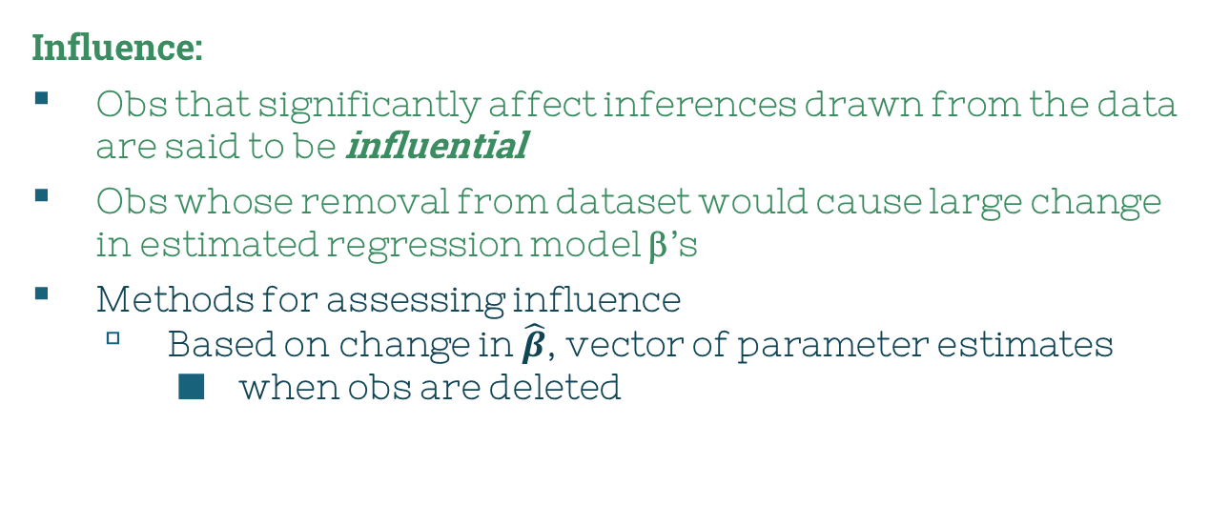
Leverage & Influence
$$π$$
Influence:
Obs that significantly affect inferences drawn from the data are said to be influential
Obs whose removal from dataset would cause large change in estimated regression model β’s
Methods for assessing influence
Based on change in $\hat{β}$, vector of parameter estimates
when obs are deleted

Slide 44
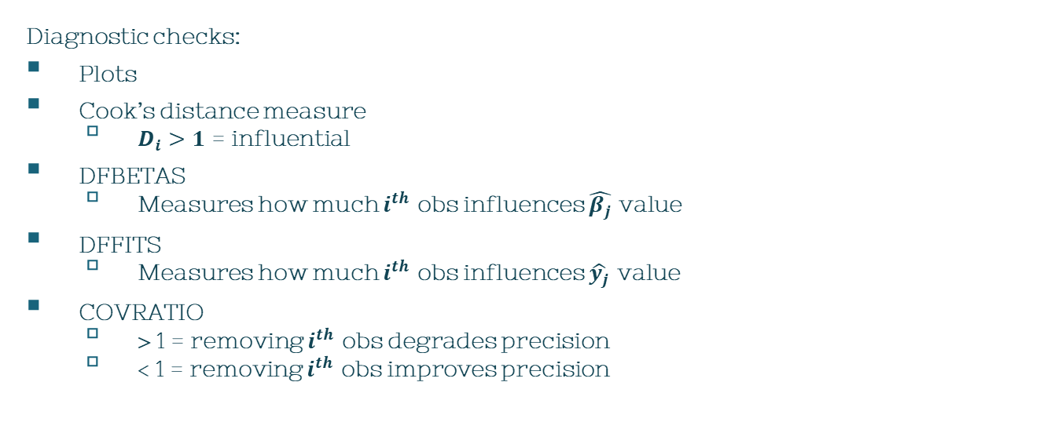
Leverage & Influence
$$π$$
Diagnostic checks:
Plots
Cook’s distance measure
$D_{i}>1$ = influential
DFBETAS
Measures how much $i^{th}$ obs influences $\hat{β_{j}}$ value
DFFITS
Measures how much $i^{th}$ obs influences $\hat{y_{j}}$ value
COVRATIO
> 1 = removing $i^{th}$ obs degrades precision
< 1 = removing $i^{th}$ obs improves precision

Slide 45

Leverage & Influence
$$π$$
After diagnostic checks:
No serious violations on assumptions?
Some assurance of no misleading
Continue to make inferences about β and future $Y$ values

Slide 46
Additional Problems in Linear Regression
Procedure
Consider all possible simple linear regressions
1st var: has largest corr w/ response
Enter the var that makes largest significant contribution to regression sum of squares
F-test
Check other vars by F-testing
Repeat steps 2-3 until all possible additions are nonsignificant & all possible deletions are significant
$$π$$
Selecting predictor vars from large set
How to choose?
What form should the regression function take?

Slide 47

Note:
you have the option for the type of method it does (forward, backward, seqrep)
Source: http://www.sthda.com/english/articles/37-model-selection-essentials-in-r/155-best-subsets-regression-essentials-in-r/

Slide 48
Additional Problems in Linear Regression
$$π$$
Selecting predictor vars from large set
Note:
No guarantee it’ll select (for example) the best 3 vars for prediction
Auto selection methods aren’t capable of indicating when transformations of vars are useful
Procedure
Consider all possible simple linear regressions
Enter the var that makes largest significant contribution to regression sum of squares
Check other vars
Repeat steps 2-3 until all possible additions are nonsignificant & all possible deletions are significant

Slide 49




Additional Problems in Linear Regression
$$π$$
Selecting predictor vars from large set
How to choose the best: examine some criterion quantity
$R^{2}$
Always $↑$ w/ inclusion of additional predictor vars
Adjusted $\overline{R^{2}}$
$\overline{R^{2}}=\frac{1−(1−R^{2})(n−1)}{n−r−1}$
A large value ($0<value<1$) is desirable
Selecting predictor vars from large set
Mallow’s $C_{p}$ statistic
Askdjgh
Akaike’s Info Criterion
Asdg
A smallest value is desirable

Slide 50
Additional Problems in Linear Regression
$$π$$
library(AICcmodavg)
bmi <- read.csv("D:/Coding/R Storage/bmi.data.csv")
attach(bmi)
age.lm <- lm(bmi ~ age, data = bmi)
sex.lm <- lm(bmi ~ sex, data = bmi)
consume.lm <- lm(bmi ~ consumption, data = bmi)
ageSex.lm <- lm(bmi ~ age + sex, data = bmi)
all.lm <- lm(bmi ~ age + sex + consumption, data = bmi)
allInteract.lm <- lm(bmi ~ age*sex*consumption, data = bmi)
model <- list(age.lm, sex.lm, consume.lm, ageSex.lm, all.lm, allInteract.lm)
model.names <- c("Age", "Sex", "Consume", "Age/Sex", "All", "All Interact")
aictab(cand.set = model, modnames = model.names)
Selecting predictor vars from large set
Akaike’s Info Criterion Example:
https://www.scribbr.com/statistics/akaike-information-criterion/

Slide 51

Additional Problems in Linear Regression
$$π$$
Collinearity
Define: predictors in a regression model are linearly dependent
If $Z≠$ full rank
Some linear combo $=0$
Columns = colinear
$⇒Z^{′}Z$ has no inverse/${(Z^{′}Z)}^{−1}=$ numerically unstable
$⇒{(Z}^{′}Z)$’s diag entries will be large
Yields large $\hat{Var}(\hat{β_{i}}$)
Difficulty in detecting “significant” $\hat{β_{i}}$

Slide 52

Additional Problems in Linear Regression
$$π$$
Collinearity
How to solve?
Delete a strongly corr pair of predictor vars
Relating $Y$ to principal components of predictor vars
Rows $z_{j}^{′}$ of $Z$ are treated as sample
First few principal components are calculated
Will be done in Ch 8.3
$Y$ is then regressed on new predictor vars

Slide 53



Additional Problems in Linear Regression
$$π$$
Bias caused by a misspecified model
Suppose the true model of has:
$Z=[Z_{1}|Z_{2}]$ w/ rank$=r+1$
AS
$E\left(ε\right)=0$
$Var\left(ε\right)=σ^{2}I$
Then, an investigator unknowingly fits a model using only first q predictors by minimizing error sum of squares [${\left(Y−Z_{1}β_{\left(1\right)}\right)}^{′}(Y−Z_{1}β_{\left(1\right)})$]
Omitted some important predictor vars from the model

Slide 54

Additional Problems in Linear Regression
$$π$$
Bias caused by a misspecified model
Because of this omission
Least squares estimator $\hat{β_{(1)}}$ becomes a biased one of $β_{(1)}$
$\hat{β_{(1)}}={ \left(Z_{1}^{′}Z_{1}\right)}^{−1}\left(Z_{1}^{′}\right)Y$
$E\left(\hat{β_{\left(1\right)}}\right)≠0⇒E\left(\hat{β_{\left(1\right)}}\right)=β_{\left(1\right)}+{ \left(Z_{1}^{′}Z_{1}\right)}^{−1}\left(Z_{1}^{′}\right)Z_{2}(β_{\left(2\right)})$
Unless columns of $Z_{1}⊥Z_{2}$ [$\left(Z_{1}^{′}\right)Z_{2}=0]$
Thus, $\hat{β_{(1)}}$ may be misleading

Slide 55
Multivariate Multiple Regression
3
Chapter 7, Section 7

Slide 56


(7-22)
$$π$$
Relationship:
m responses
$Y_{1},…,Y_{m}$
Single set of predictor vars
$z_{1},…,z_{r}$
$ε^{′}=[ε_{1},…,ε_{m}]$
$E\left(ε\right)=0$
$Var\left(ε\right)=Σ$
$$Y_{1}=β_{01}+β_{11}z_{1}+…+β_{r1}z_{r}+ε_{1}$$
$$Y_{2}=β_{02}+β_{12}z_{1}+…+β_{r2}z_{r}+ε_{2}$$
$$. . .$$
$$. . .$$
$$. . .$$
$$Y_{m}=β_{0m}+β_{1m}z_{1}+…+β_{rm}z_{r}+ε_{m}$$

Slide 57


(7-23)
$$π$$
$$Z_{(nx(r+1))}=\left[\begin{matrix}z_{10} & z_{11} & … & z_{1r} \\ . & . & . & . \\ . & . & . & . \\ . & . & . & . \\ z_{n0} & z_{n1} & … & z_{nr}\end{matrix}\right]$$

Slide 58

(7-23)
$$π$$

Slide 59


(7-23)
$$π$$
The multivariate linear regression model is:
$Y_{(nxm)}=Z_{(nx\left(r+1\right))}β_{(\left(r+1\right)xm)}+ε_{(nxm)}$
With
$E\left(ε_{\left(i\right)}\right)=0$
$Cov\left(ε_{\left(i\right)},ε_{\left(k\right)}\right)=σ_{ik}I$
$i,k=1,2,…,m$
$$unknown=\left\{\begin{aligned}β \\ σ_{ik}\end{aligned}\right.$$
Let Z have $j^{th}$ row
$[z_{j0},…,z_{jr}]$
m obs on $j^{th}$ trial have Cov matrix $Σ=\{σ_{ik}\}$
Obs from diff trials are uncorr

Slide 60


(7-24)-(7-26)
$$π$$
$i^{th}$ response $Y_{(i)}$ follows:
$Y_{(i)}=Zβ_{(i)}+ε_{(i)}$ (7-24)
With
$Cov\left(ε_{\left(i\right)}\right)=σ_{ii}I$
$i=1,2,…,m$
Note: Errors from diff responses on same trial can be corr
Determine univariate least squares estimates $\hat{β_{(i)}}$ from $Y_{(i)}$
$\hat{β_{(i)}}={\left(Z^{′}Z\right)}^{−1}(Z^{′})Y_{(i)}$ (7-25)
Given:
$Y$
Values of $Z$ w/ full col rank
Obtain:
$\hat{β}={(Z^{′}Z)}^{−1}{(Z}^{′})Y$ (7-26)

Slide 61


Question: Example 7.8
$$π$$
Fitting Multivar Straight-Line Regression Model
Examples of what $y_{1}$& $y_{2}$ can be
7.25: Amitriptyline overdose
$y_{1}=$ total TCAD plasma lvl
$y_{2}=$ Amt of amitriptyline in TCAD plasma lvl
$z_{1}=$ gender
SAT scores
$y_{1}=$ Math score
$y_{2}=$ Reading score
$z_{1}=$ hours of studying
$$z_{1}$$ | $$y_{1}$$ | $$y_{2}$$
0 | 1 | -1
1 | 4 | -1
2 | 3 | 2
3 | 8 | 3
4 | 9 | 3

Slide 62

Question: Example 7.8
$$π$$
Fitting Multivar Straight-Line Regression Model
Interpreting results
summary(model)
2 results
One for each response
Source:
https://bookdown.org/egarpor/PM-UC3M/lm-iii-mult.html

Slide 63

Question: Example 7.8
$$π$$
Fitting Multivar Straight-Line Regression Model
Interpreting results if your model is good
Coefficients
Understand effects of factors
Direction
magnitude
P-value
Keep/remove var
$R^{2}$
How well does model explain variation in data
$\overline{R^{2}}$
Penalizes number of independent vars used in model

Slide 64
Question: MV vs UV
$$π$$
Why do multivariate multiple regression rather than fitting separate univariate multiple regression?
MV multiple regression
n for 1 result
result ∀ response var
Results would be identical if we ran separate models
Except variance-covariance for model coefficients
Coefficients from both models covary
Vary in correlation with another related variant
Covariance needs to be considered when determining if predictor is jointly contributing to both models

Slide 65

Result 7.9
$$π$$
For the least squares estimator $\hat{β}=\left[\hat{β_{(1)}}\left|\hat{β_{\left(2\right)}}\right|…|\hat{β_{(m)}}\right]$ determined under the multivariate multiple regression model (7-23) w/ full rank $\left(Z\right)=r+1<n$,
$E\left(\hat{β_{\left(i\right)}}\right)=β_{(i)}⇔E\left(\hat{β}\right)=β$
$Cov\left(\hat{β_{\left(i\right)}},\hat{β_{\left(k\right)}}\right)=σ_{ik}{(Z^{′}Z)}^{−1}$
$i,k=1,2,…,m$

Slide 66

Result 7.9
$$π$$
The residuals $\hat{ε}=\left[\hat{ε_{(1)}}\left|\hat{ε_{\left(2\right)}}\right|…|\hat{ε_{(m)}}\right]=Y−Z\hat{β}$ satisfy
$E\left(\hat{ε_{\left(i\right)}}\right)=0⇒E\left(\hat{ε}\right)=0$
$E\left(\hat{ε_{\left(i\right)}′}\hat{ε_{\left(k\right)}}\right)=\left(n−r−1\right)σ_{ik}⇒E\left(\frac{1}{n−r−1}\hat{ε^{′}}\hat{ε}\right)=Σ$
Note: uncorrelated=$\left\{\begin{aligned}\hat{ε} \\ \hat{β}\end{aligned}\right.$

Slide 67

Result 7.9: Proof
$$π$$
$i^{th}$ response follows multiple regression model:
$Y_{\left(i\right)}={Zβ}_{(i)}ε_{(i)}$
$E\left(ε_{\left(i\right)}\right)=0$
$E\left(ε_{\left(i\right)}ε_{\left(i\right)}^{′}\right)=σ_{ii}I$
From (7-24)
$\hat{β_{(i)}}−β_{\left(i\right)}={\left(Z^{′}Z\right)}^{−1}\left(Z^{′}\right)Y_{\left(i\right)}−β_{\left(i\right)}={\left(Z^{′}Z\right)}^{−1}\left(Z^{′}\right)ε_{\left(i\right)}$
$E\left(\hat{β_{(i)}}\right)=0$
$\hat{ε_{(i)}}=Y_{\left(i\right)}−\hat{Y_{\left(i\right)}}=\left[I−{Z\left(Z^{′}Z\right)}^{−1}\left(Z^{′}\right)\right]Y_{\left(i\right)}=[I−{Z\left(Z^{′}Z\right)}^{−1}\left(Z^{′}\right)]ε_{\left(i\right)}$
$E\left(\hat{ε_{(i)}}\right)=0$

Slide 68

Result 7.9: Proof
$$π$$
$$Cov\left(\hat{β_{\left(i\right)}},\hat{β_{\left(k\right)}}\right)=E\left(\hat{β_{(i)}}−β_{\left(i\right)}\right){\left(\hat{β_{\left(k\right)}}−β_{\left(k\right)}\right)}^{′}={\left(Z^{′}Z\right)}^{−1}\left(Z^{′}\right)E\left(ε_{\left(i\right)}ε_{\left(k\right)}^{′}\right){Z\left(Z^{′}Z\right)}^{−1}=σ_{ik}{\left(Z^{′}Z\right)}^{−1}$$
Using Result 4.9
$U=$ rand vector
$A=$ fixed matrix
$E\left[U^{′}AU\right]=E\left[tr\left(AUU^{′}\right)\right]=tr[AE(UU^{′})]$

Slide 69

Result 7.9: Proof
$$π$$
Consequently, from Result 7.1’s proof & using Result 2A.12
$E\left(ε_{\left(i\right)}ε_{\left(k\right)}^{′}\right)=E\left(ε_{\left(i\right)}^{′}(1−{Z\left(Z^{′}Z\right)}^{−1}\left(Z^{′}\right))ε_{\left(k\right)}\right)=$
$=tr\left[\left(I−{Z\left(Z^{′}Z\right)}^{−1}\left(Z^{′}\right)\right)σ_{ik}I\right]=σ_{ik}tr\left[I−{Z\left(Z^{′}Z\right)}^{−1}\left(Z^{′}\right)\right]=$
$=σ_{ik}(n−r−1)$
$$E\left(\hat{ε_{\left(i\right)}′}\hat{ε_{\left(k\right)}}\right)=\left(n−r−1\right)σ_{ik}⇒E\left(\frac{1}{n−r−1}\hat{ε^{′}}\hat{ε}\right)=Σ$$
$Σ=$ unbiased estimator

Slide 70

Result 7.9: Proof
$$π$$
$$Cov\left(\hat{β_{\left(i\right)}},\hat{β_{\left(k\right)}}\right)=E\left(\hat{β_{(i)}}−β_{\left(i\right)}\right){\left(\hat{β_{\left(k\right)}}−β_{\left(k\right)}\right)}^{′}=$$
$={\left(Z^{′}Z\right)}^{−1}\left(Z^{′}\right)E\left(ε_{\left(i\right)}ε_{\left(k\right)}^{′}\right)\left(I−{Z\left(Z^{′}Z\right)}^{−1}\left(Z^{′}\right)\right)$
$={\left(Z^{′}Z\right)}^{−1}\left(Z^{′}\right)σ_{ik}(I)\left(I−{Z\left(Z^{′}Z\right)}^{−1}\left(Z^{′}\right)\right)$
${=σ}_{ik}\left({\left(Z^{′}Z\right)}^{−1}\left(Z^{′}\right)−{\left(Z^{′}Z\right)}^{−1}\left(Z^{′}\right)\right)=0$
∴ Each element of $\hat{β}$ is uncorr w/ each element of $\hat{ε}$

Slide 71


Result 2A.12
$$π$$
Let:
$A,B$
$kxk$ symmetric matrices
$c$
scalar
$tr\left(cA\right)=c[tr\left(A\right)]$
$tr\left(A±B\right)=tr\left(A)±tr(B\right)$
$tr\left(AB\right)=tr\left(BA\right)$
$tr\left(B^{′}AB\right)=tr(A)$
$tr\left(AA^{′}\right)=\sum_{i=1}^{k}{\sum_{j=1}^{k}{a_{ij}^{2}}}$

Slide 72


Result 4.9
$$π$$
Let:
$A$
$kxk$ symmetric matrix
$x$
$kx1$ vector
Then
$x^{′}Ax=tr\left(x^{′}Ax\right)=tr\left(Axx^{′}\right)$
$tr\left(A\right)=\sum_{i=1}^{k}{λ_{i}}$
$λ_{i}=$ eigenvalues of $A$

Slide 73


Result 7.10
$$π$$
Let the multivariate multiple regression model in (7-23) hold
full rank $\left(Z\right)=r+1$
$n≥\left(r+1\right)+m$
Let the $ε\sim N_{n}(μ,σ^{2})$. Then $\hat{β}={(Z^{′}Z)}^{−1}Z^{′}Y$ is the MLE of β
$\hat{β}\sim N(μ,σ^{2})$
$E\left(\hat{β}\right)=β$
$Cov\left(\hat{β_{\left(i\right)}},\hat{β_{\left(k\right)}}\right)=σ_{ik}{(Z^{′}Z)}^{−1}$
Also, $\hat{β}$ is independent of the MLE of the positive definite Σ given by
$\hat{Σ}=\frac{1}{n}(Y−Z\hat{β})′(Y−Z\hat{β})$
$n\hat{Σ}\sim W_{p,n−r−1}(Σ)$
The maximum likelihood
$$L\left(\hat{μ},\hat{Σ}\right)={(2π)}^{−\frac{mn}{2}}{|\hat{Σ}|}^{−\frac{n}{2}}e^{−\frac{mn}{2}}$$

Slide 74


Likelihood Ratio Tests for Regression Parameters
$$π$$
$$H_{0}:β_{(2)}=0$$
$β=\left[\begin{matrix}β_{(1)} \\ −−−− \\ β_{(2)}\end{matrix}\right]$
$β_{(1)}=\left(q+1\right)xm$
$β_{(2)}=\left(r−q\right)xm$
General model:
$E\left(Y\right)=Zβ=\left[Z_{1}|Z_{2}\right]\left[\begin{matrix}β_{(1)} \\ −−−− \\ β_{(2)}\end{matrix}\right]=Z_{1}β_{(1)}$+ $Z_{2}β_{(2)}$
$Z_{1}=nx\left(q+1\right)$
$Z_{2}=nx\left(r−q\right)$

Slide 75

Likelihood Ratio Tests for Regression Parameters
$$π$$
From Result 7.10, likelihood ratio $Λ$ can be expressed in terms of generalized variances:
$Λ=\frac{\max_{β_{\left(1\right)},Σ}L(β_{\left(1\right)},Σ)}{\max_{β,Σ}L(β,Σ)}=\frac{L(\hat{β_{\left(1\right)}}, \hat{Σ_{1}})}{L(\hat{β},\hat{Σ})}={\left(\frac{|\hat{Σ_{1}}|}{|\hat{Σ}|}\right)}^{\frac{n}{2}}$
Equivalently, Wilk’s lambda stat can be used
$Λ^{\frac{n}{2}}=\left(\frac{|\hat{Σ}|}{|\hat{Σ_{1}}|}\right)$

Slide 76

Result 7.11
$$π$$
Let the multivariate multiple regression model in (7-23) hold
full rank $\left(Z\right)=r+1$
$\left(r+1\right)+m≤n$.
Let the errors $ε\sim N_{n}(μ,σ^{2})$. Under $H_{0}:β_{(2)}=0,$
$n\hat{Σ}\sim W_{p,n−r−1}\left(Σ\right)$
independently of $n\left(\hat{Σ_{1}}−\hat{Σ}\right)\sim W_{p,r−q}(Σ)$.

Slide 77

Result 7.11
$$π$$
The likelihood ratio test of $H_{0}$ is $≡$ to rejecting $H_{0}$ for large values of
$−2lnΛ=−nln\left(\frac{\left|\hat{Σ}\right|}{\left|\hat{Σ_{1}}\right|}\right)=−nln\left(\frac{\left|n\hat{Σ}\right|}{\left|n\hat{Σ}+n(\hat{Σ_{1}}−\hat{Σ})\right|}\right)$.
For n large, the modified statistic $−\left[n−r−1−\frac{1}{2}(m−r+q+1)\right]ln\left(\frac{\left|\hat{Σ}\right|}{\left|\hat{Σ_{1}}\right|}\right)$ has, to a close approx, $χ_{m(r−q)}^{2}$
Note: Read Supplement 7A for proof

Slide 78


Likelihood Ratio Tests for Regression Parameters
$$π$$
To aid in selection of simple but adequate MV multiple regression model
Information criterion
$AIC=nln\left(\left|\hat{Σ_{d}}\right|\right)−2p(d)$
$d=$ number of predictor vars (includes intercept)
$\hat{Σ_{d}}=\frac{1}{n}(residual sum of squares \& cross products matrix)$

Slide 79

Other Multivariate Test Statistics
$$π$$
Other proposed tests for $H_{0}:β_{(2)}=0$
Wilk’s lambda
Pillai’s trace
Hotelling-Lawley trace
Roy’s greatest root
R
test.man <- manova(model)
summary(test.man, test = ‘stat’)
Pillai
Wilks
Hotelling-Lawley
Roy
Code: https://www.r-bloggers.com/2016/12/manova-test-statistics-with-r/

Slide 80

Predictions from Multivariate Multiple Regressions
$$π$$
Suppose $Y=Zβ+ε$ has been fitted & checked for any inadequacies
If adequate
$→$ use for predictive purposes
Mean responses
Forecast new responses

Slide 81

Predictions from Multivariate Multiple Regressions
$$π$$
Mean responses
Corresponding to fixed values $z_{0}$ of predictor vars
Inferences can be made using distr theory in Result 7.10
$\hat{β^{′}}z_{0}\sim N_{m}(β^{′}z_{0},z_{0}^{′}{\left(Z^{′}Z\right)}^{−1}(z_{0})Σ)$
$n\hat{Σ}\sim W_{n−r−1}(Σ)$
$β^{′}z_{0}=$ unknown value of regression function at $z_{0}$

Slide 82

Predictions from Multivariate Multiple Regressions
$$π$$
Mean responses
$$T^{2}={\left(\frac{\hat{β^{′}}z_{0}−β^{′}z_{0}}{\sqrt{z_{0}^{′}{\left(Z^{′}Z\right)}^{−1}(z_{0})}}\right)}^{′}{\left(\frac{n}{n−r−1}\hat{Σ}\right)}^{−1}\left(\frac{\hat{β^{′}}z_{0}−β^{′}z_{0}}{\sqrt{z_{0}^{′}{\left(Z^{′}Z\right)}^{−1}(z_{0})}}\right)$$
$100\left(1−α\right)\%$ confidence ellipsoid for $β^{′}z_{0}$
${(β^{′}z_{0}−\hat{β^{′}}z_{0})}^{′}$ ${\left(\frac{n}{n−r−1}\hat{Σ}\right)}^{−1}(β^{′}z_{0}−\hat{β^{′}}z_{0})≤z_{0}^{′}{\left(Z^{′}Z\right)}^{−1}(z_{0})\left[\left(\frac{m\left(n−r−1\right)}{n−r−m}\right)F_{m,n−r−m}(α)\right]$
$F_{m,n−r−m}(α)$ is upper ${100(α)}^{th}$ percentile of F-distr w/ m, n-r-m df

Slide 83

Predictions from Multivariate Multiple Regressions
$$π$$
Mean responses
$100\left(1−α\right)\%$ simultaneous confidence intervals for $E\left(Y_{i}\right)=z_{0}^{′}β_{(i)}$
$z_{0}^{′}\hat{β_{(i)}}±\sqrt{\left(\frac{m\left(n−r−1\right)}{n−r−m}\right)F_{m,n−r−m}(α)}\sqrt{z_{0}^{′}{\left(Z^{′}Z\right)}^{−1}(z_{0})\left(\frac{n}{n−r−1}\hat{σ_{ii}}\right)}$
$i=1,2,…,m$
$\hat{β_{(i)}}=i^{th}$ col of $\hat{β}$
$\hat{σ_{ii}}=i^{th}$ diag element of $\hat{Σ}$

Slide 84

Predictions from Multivariate Multiple Regressions
$$π$$
Forecasting New Responses
$$Y_{0}=β^{′}z_{0}+ε_{0}$$
$Y_{0}−β^{′}z_{0}={\left(β−\hat{β}\right)}^{′}z_{0}+ε_{0}\sim N_{m}(0,(1+z_{0}^{′}{\left(Z^{′}Z\right)}^{−1}(z_{0}))Σ)$
$100\left(1−α\right)\%$ prediction ellipsoid for $Y_{0}$
${(Y_{0}−\hat{β^{′}}z_{0})}^{′}$ ${\left(\frac{n}{n−r−1}\hat{Σ}\right)}^{−1}(Y_{0}−\hat{β^{′}}z_{0})≤(1+z_{0}^{′}{\left(Z^{′}Z\right)}^{−1}\left(z_{0}\right))\left[\left(\frac{m\left(n−r−1\right)}{n−r−m}\right)F_{m,n−r−m}(α)\right]$
$F_{m,n−r−m}(α)$ is upper ${100(α)}^{th}$ percentile of F-distr w/ m, n-r-m df

Slide 85

Predictions from Multivariate Multiple Regressions
$$π$$
Forecasting New Responses
$100\left(1−α\right)\%$ simultaneous confidence intervals for individual $Y_{0i}$
$z_{0}^{′}\hat{β_{(i)}}±\sqrt{\left(\frac{m\left(n−r−1\right)}{n−r−m}\right)F_{m,n−r−m}(α)}\sqrt{(1+z_{0}^{′}{\left(Z^{′}Z\right)}^{−1}\left(z_{0}\right))\left(\frac{n}{n−r−1}\hat{σ_{ii}}\right)}$
$i=1,2,…,m$
$\hat{β_{(i)}}=i^{th}$ col of $\hat{β}$
$\hat{σ_{ii}}=i^{th}$ diag element of $\hat{Σ}$

Slide 86
References
Britannica
https://www.britannica.com/science/estimated-regression-equation
MV Linear Regression Models Lecture Slides
https://isip.piconepress.com/courses/temple/ece_3522/lectures/current/lecture_23.pdf
Autocorrelation
https://corporatefinanceinstitute.com/resources/data-science/autocorrelation/
Durbin-Watson Test
https://www.statology.org/durbin-watson-test-r/
Diagnostics for Leverage & Influence Slides
https://www.sjsu.edu/faculty/guangliang.chen/Math261a/Ch6slides-leverage-influence.pdf
MV Multiple Regression
https://library.virginia.edu/data/articles/getting-started-with-multivariate-multiple-regression
http://sellsidehandbook.com/2018/12/03/multivariate-regression-and-interpreting-regression-results/

Slide 87
~Fin~
Any lingering questions?

